Slide 1

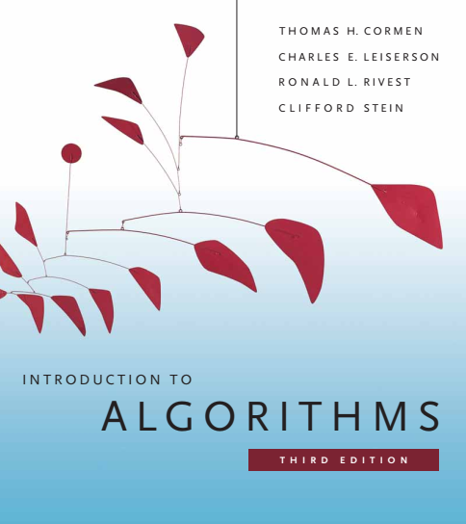
Design and Analysis of Algorithms
Dr. Sajid Iqbal
sajidiqbal.pk@gmail.com
Reference Book
Introduction to Algorithms 3rd Edition By Thomas H. Cormen et. al.
https://mitpress.mit.edu/books/introduction-algorithms-third-edition
COMEDXD

Slide 2
Hash Functions
Chapter 11: hash tables

Slide 3
Introduction
A hash function is any function that is used to map data of arbitrary size to fixed-size values.
The output of a hash function are called hash values, hash codes, digests, or simply hashes.
The values are used to index a fixed-size table called a hash table
Hashing: Use of a hash function to index a hash table
We will discuss different hash functions in this lecture
Heuristic Hashing: hashing by division and hashing by multiplication
Universal hashing: uses randomization to provide provably good performance
There is need to design a categorization scheme for hash functions

Slide 4

Hash functions
A good hash function tries to distribute the keys uniformly among all slots of hash table
Each key hashed in DAT is independent of its previous key mapping
However, keys may not be drawn from uniform distribution
Keys may not be drawn independently
If we have knowledge about keys’ distribution, we can design a good hash function
Example: if k is drawn from uniform distribution independently then
$h(k)=\left\lfloor km\right\rfloor$ can yield simple uniform distribution of keys
For efficiency purpose, keys must be natural numbers
$N=\{1,2,3,4,….,n\}$
IF keys are not natural numbers, convert them to natural numbers

Slide 5
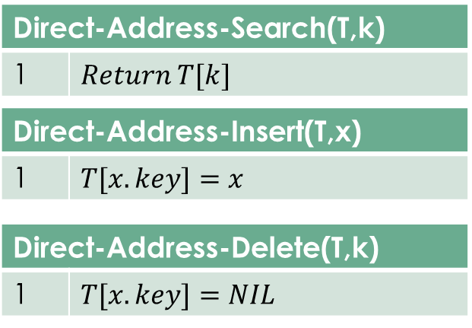









Uniform Hashing
T | Add
 | 0
 | 1
 | 2
 | 3
 | 4
 | 5
 | 6
 | 7
 | 8
/ | 9
$$k_{0}$$
0
$$k_{1}$$
$$k_{2}$$
$$k_{3}$$
$$k_{4}$$
$$k_{5}$$
$$k_{6}$$
$$k_{7}$$
$$k_{8}$$
M-1

Slide 6

The division Method
K | K mod 8 | Bits
0 | 0 mod 8=0 | 1
1 | 1 | 1
2 | 2 | 2
3 | 3 | 2
4 | 4 | 3
5 | 5 | 3
6 | 6 | 3
7 | 7 | 3
8 | 0 | 1
9 | 1 | 1
10 | 2 | 2
11 | 3 | 2
12 | 4 | 3
13 | 5 | 3
14 | 6 | 3
15 | 7 | 3
16 | 0 | 1
In this method keys are divided by the number of slots in hash table
If there are $m$ slots in hash table and $k$ represents the key then
$h\left(k\right)=k mod m$ i.e. $100 mod 12=4$ so key $100$ will be placed in slot $4$
In designing division method, avoid certain values of $m$
$M$ should not be power of $2$ as $h\left(k\right)=k mod m$ selects the lower order bits of k
Some bits of the key are not used in the hash function
A good hash function always tries to use all bits of keys
A prime not too close to an exact power of $2$ is often a good choice for $m$
Consecutive keys map to consecutive hash values in the hash table.
This leads to a poor performance
Consecutive keys occupy consecutive memory locations and it forms the cluster of keys leaving other spaces blank in hash table

Slide 7









The Multiplication Method
This method operates in two steps
Multiply the key $k$ with a constant A such that $0<A<1$ and extract the fractional part of $kA$
Multiply it with m and take the floor of the result
$h\left(k\right)=\left\lfloor m(kA mod 1)\right\rfloor$ here $kA mod 1$ represents the fractional part
Let
$W$: word size of the machine in bits
$K$: the key that fits into single word
$s$: it is an integer in the range $0<s<2^{w}$
$A$: multiplication constant such that $A=\frac{s}{2^{w}}$
The value of m is not critical in this method and typically it is chosen to be power of two
$$w bits$$
$$k$$
$$S=A.2^{w}$$
$$r_{1}$$
$$r_{0}$$
$$extract p bits$$
$$h(k)$$

Slide 8







Multiply $k$ by $w$-bit integer $s$
Result is $2w$ bit integer
$r_{1}2^{w}+r_{0}$
The desired $p$-bit has value that consists of $p$ most significant bits of $r0$
Example:
$K=123, m=100, A=0.618033$
$h(123)=\left\lfloor 100∗(\left(123∗0.618033\right)mod 1)\right\rfloor$
$h(123)=\left\lfloor 100∗\left(76.018059\right) mod 1\right\rfloor$
$h(123)=\left\lfloor 100∗\left(0.018059\right)\right\rfloor$
$h\left(123\right)=\left\lfloor \left(1.8059\right)\right\rfloor =1$
This method can work better for some values of A
Donald Knuth suggests that $A≈\sqrt{5}−1=0.6180$ can work better
$$w bits$$
$$k$$
$$S=A.2^{w}$$
$$r_{1}$$
$$r_{0}$$
$$extract p bits$$
$$h(k)$$

Slide 9


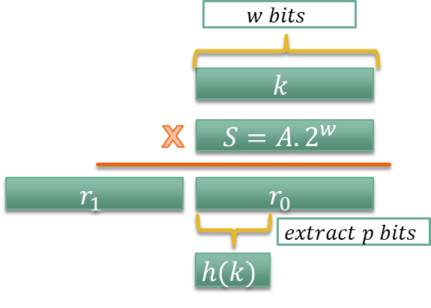

Multiplication Method: Example
$K=123456, p=14, m=2^{14}=16384, w=32$
Choose $A =\frac{s}{2^{32}}$that is closest to $\frac{\sqrt{5}−1}{2}$,
$A=\frac{2654435769}{2^{32}}$
$k.s=327706022297664=\left(76300∗2^{32}\right)+17612864$
Hence $r_{1}=76300, r_{0}=17612864$
14 most significant bits of $r_{0}$ yields the value of $h(k)=67$
17612864=‭ 0000 0001 0000 1100 1100 0000 0100 0001‬

Slide 10

Universal hashing
Problem: Any fixed hash function can hash all keys to same slot in worst case
Solution (Universal Hashing): choose the hash function randomly in a way that it is independent of keys
Universal Hashing
Form a collection of carefully designed hash functions $𝓗$
For each execution, choose a hash function randomly from $𝓗$
This random selection of hash function will guarantee good average performance for any input
If $k,l$ are distinct keys from $U$ then $h(k)=h(l)$is at most $\frac{\left|𝓗\right|}{m}$
A randomly chosen hash function $h(k)εℋ,$the chance of collision of $h(k),h(l)$will be $1/m$

Slide 11
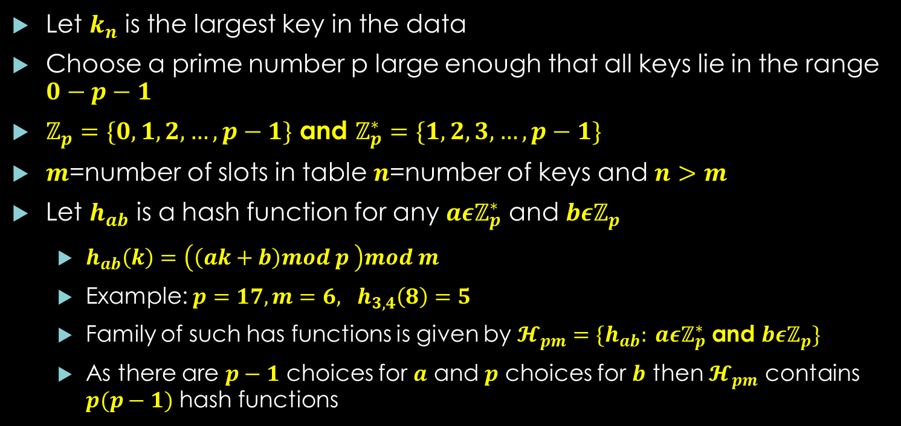

Designing $ℋ$
Let $k_{n}$ is the largest key in the data
Choose a prime number p large enough that all keys lie in the range $0−p−1$
$ℤ_{p}=\{0,1,2,…, p−1\}$ and $ℤ_{p}^{∗}=\{1,2,3,…,p−1\}$
$m$=number of slots in table $n$=number of keys and $n>m$
Let $h_{ab}$ is a hash function for any $a{εℤ}_{p}^{∗}$ and $bεℤ_{p}$
$h_{ab}\left(k\right)=\left(\left(ak+b\right)mod p \right)mod m$
Example: $p=17, m=6, h_{3,4}\left(8\right)=5$
Family of such has functions is given by $𝓗_{pm}=\{h_{ab}: a{εℤ}_{p}^{∗}$ and $bεℤ_{p}\}$
As there are $p−1$ choices for $a$ and $p$ choices for $b$ then $𝓗_{pm}$ contains $p(p−1)$ hash functions

Slide 12



Thanks for watching
Dr. Sajid Iqbal
Assistant Professor
Department of Computer Science
Bahauddin Zakariya University, Multan
sajidiqbal.pk@gmail.com
https://github.com/sajjo79/Design_and_Analysis_of_Algorithms
COMEDXD
Allah Hafiz

Slide 13
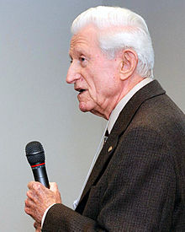

Linear Probing
A simple method of collision avoidance
Hash function
$h\left(k\right)=k mod 10$
If collision occurs place the colliding record next in hash table
It creates the clustering
 | T
0
1
2
3
4
5
6
7
8
9
Gene Amdahl
1922-2015
71
64
36
56

